Slide 1
Object-Oriented Software Design (lecture 7)

Slide 2
Object-oriented Concepts
Basic Mechanisms:
  Objects:
    A real-world entity.
    A system is designed as a set of interacting objects.
    Consists of data (attributes) and functions (methods) that operate on data
    Hides organization of internal information (Data abstraction)
    Examples: an employee, a book etc.

Slide 3
Object-oriented Concepts
  Class:
    Instances are objects
    Template for object creation
    Examples: set of all employees, different types of book

Slide 4
Object-oriented Concepts
  Methods and message:
    Operations supported by an object
    Means for manipulating the data of other objects
    Invoked by sending message
    Examples: calculate_salary, issue-book, member_details, etc.

Slide 5
Object-oriented Concepts
LibraryMember
Base Class
LibraryMember
Base Class
Faculty
Students
Staff
Derived
Classes
Faculty
Students
Staff
Multiple
Inheritance
UnderGrad
PostGrad
Research
UnderGrad
PostGrad
Research

Slide 6
Object-oriented Concepts
Key Concepts:
  Abstraction:
    Consider aspects relevant for certain purpose
    Suppress non-relevant aspects
    Supported at two levels i.e. class level where base class is an abstraction & object level where object is a data abstraction entity

Slide 7
Object-oriented Concepts
  Encapsulation:
    Objects communicate outside world through messages
    Objects data encapsulated within its methods
    Preventing third party’s access to data.

Slide 8
Object-oriented Concepts
Methods
m4
m3
Data
m5
m2
m6
m1
Concept of encapsulation

Slide 9
Object-oriented Concepts
  Polymorphism:
    Denotes to poly (many) morphism (forms)
    Same message result in different actions by different objects (static binding)

Slide 10
Object-oriented Concepts
  Composite objects:
    Object containing other objects

Slide 11
Advantages of Object-oriented design
  Code and design reuse
  Increased productivity
  Ease of testing & maintenance
  Better understandability
  Its agreed that increased productivity is chief advantage

Slide 12
Advantages of Object-oriented design
  Initially incur higher costs, but after completion of some projects reduction in cost become possible
  Well-established OO methodology and environment can be managed with 20-50% of traditional cost of development

Slide 13
Object modelling using UML
  UML is a modelling language
  Not a system design or development methodology
  Used to document object-oriented analysis and design
  Independent of any specific design methodology

Slide 14
Why UML is required?
  Model is required to capture only important aspects
  UML a graphical modelling tool, easy to understand and construct
  Helps in managing complexity

Slide 15
UML diagrams
  Nine diagrams to capture different views of a system
  Provide different perspectives of the software system
  Diagrams can be refined to get the actual implementation of the system

Slide 16
UML diagrams
  Views of a system
    User’s view
    Structural view
    Behavioral view
    Implementation view
    Environmental view

Slide 17
UML diagrams
Behavioural View
Sequence Diagram
Collaboration Diagram
- State-chart Diagram
- Activity Diagram
Structural View
Class Diagram
Object Diagram
User’s View
Use Case
Diagram
Implementation View
Component Diagram
Environmental View
Deployment Diagram
Diagrams and views in UML

Slide 18
Are all views required?
  NO
  Use case model, class diagram and one of the interaction diagram for a simple system
  State chart diagram in case of many state changes
  Deployment diagram in case of large number of hardware components

Slide 19
Use Case model
  Consists of set of “use cases”
  An important analysis and design artifact
  Other models must confirm to this model
  Not really an object-oriented model
  Represents a functional or process model

Slide 20
Use Cases
  Different ways in which system can be used by the users
  Corresponds to the high-level requirements
  Represents transaction between the user and the system
  Define behavior without revealing internal structure of system
  Set of related scenarios tied together by a common goal

Slide 21
Use Cases
  Normally, use cases are independent of each other
  Implicit dependencies may exist
  Example: In Library Automation System, renew-book & reserve-book are independent use cases. But in actual implementation of renew-book, a check is made to see if any book has been reserved using reserve-book

Slide 22
Example of
Use Cases
  For library information system
    issue-book
    Query-book
    Return-book
    Create-member
    Add-book, etc.

Slide 23
Representation of
Use Cases
  Represented by use case diagram
  Use case is represented by ellipse
  System boundary is represented by rectangle
  Users are represented by stick person icon (actor)
  Communication relationship between actor and use case by line
  External system by stereotype

Slide 24
Example of
Use Cases
Tic-tac-toe game
Play Move
Player
Use case model

Slide 25
Why develop
Use Case diagram?
  Serves as requirements specification
  Users identification helps in implementing security mechanism through login system
  Another use in preparing the documents (e.g. user’s manual)

Slide 26
Factoring
Use Cases
  Complex use cases need to be factored into simpler use cases
  Represent common behavior across different use cases
  Three ways of factoring
    Generalization
    Includes
    Extends

Slide 27
Factoring Using
Generalization
Pay membership fee
Pay through credit card
Pay through library pay card
Use case generalization

Slide 28
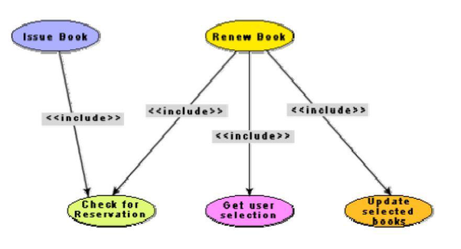
Factoring Using
Includes

Slide 29
Factoring Using
Extends
Base
use case
<<extends>>
Common
use case
Use case extension

Slide 30
Class diagram
  Describes static structure of a system
  Main constituents are classes and their relationships:
    composition
    Aggregation
    Association
    Various kinds of dependencies

Slide 31
Class diagram
  Entities with common features, i.e. attributes and operations
  Classes are represented as solid outline rectangle with compartments
  Compartments for name, attributes & operations
  Attribute and operation compartment are optional for reuse purpose

Slide 32
Example of
Class diagram
LibraryMember
LibraryMember
LibraryMember
Member Name
Membership Number
Address
Phone Number
E-Mail Address
Membership Admission Date
Membership Expiry Date
Books Issued
Member Name
Membership Number
Address
Phone Number
E-Mail Address
Membership Admission Date
Membership Expiry Date
Books Issued
issueBook( );
findPendingBooks( );
findOverdueBooks( );
returnBook( );
findMembershipDetails( );
Different representations of the LibraryMember class

Slide 33
Association Relationship
Library Member
1
borrowed by
*
Book
Association between two classes

Slide 34
Aggregation Relationship
  Represent a whole-part relationship
  Represented by diamond symbol at the composite end
  Cannot be reflexive(i.e. recursive) cannot contain objects of same class as itself.
  Not symmetric
  It can be transitive

Slide 35
Aggregation Relationship
Document
1
*
1
*
Line
Paragraph
Representation of aggregation

Slide 36
Composition Relationship
  Life of item is same as the order
  One item will create an order, no items will eliminate the order.
Order
1
*
Item
Representation of composition

Slide 37
Class Dependency
Dependent Class
Independent Class
Representation of dependence between class

Slide 38
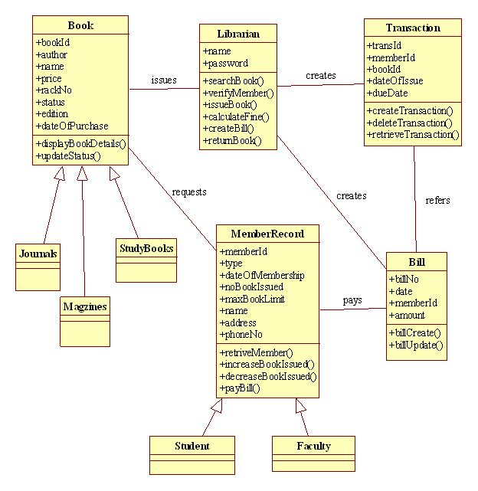


Slide 39
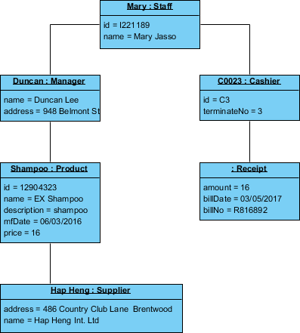
OBJECT DIAGRAM

Slide 40
Interaction diagram
  Models how groups of objects collaborate to realize some behaviour
  Typically each interaction diagram realizes behaviour of a single use case

Slide 41
Interaction diagram
  Two kinds: Sequence & Collaboration
  Two diagrams are equivalent but portrays different perspective
  These diagram play a very important role in the design process

Slide 42
Sequence diagram
  Shows interaction among objects as two-dimensional chart
  Objects are shown as boxes at top
  If object created during execution then shown at appropriate place
  Objects existence are shown as dashed lines (lifeline)
  Objects activeness, shown as rectangle on lifeline

Slide 43
Sequence diagram
  Messages are shown as arrows
  Message labelled with message name
  Message can be labelled with control information
  Two types of control information: condition ([]) & an iteration (*)

Slide 44
Example of
Sequence diagram
:Library
Boundary
:Library
Book
Renewal
Controller
:Library
Book
Register
:Book
:Library
Member
renewBook
find MemberBorrowing
displayBorrowing
selectBooks
bookSelected
* find
[reserved]
[reserved]
apology
update
apology
confirm
confirm
updateMemberBorrowing
Sequence Diagram for the renew book use case

Slide 45
Collaboration diagram
  Shows both structural and behavioural aspects
  Objects are collaborator, shown as boxes
  Messages between objects shown as a solid line
  Message is shown as a labelled arrow placed near the link
  Messages are prefixed with sequence numbers to show relative sequencing

Slide 46
Example of
Collaboration diagram
:Library
Book
Register
6: * find
:Book
[reserved]
9: update
8: apology
5: book
Selected
10: confirm
:Library
Boundary
1: renewBook
:Library
Book
Renewal
Controller
[reserved]
7: apology
3: display
Borrowing
4: selectBooks
2: findMemberBorrowing
12: confirm
:Library
Member
updateMemberBorrowing
Collaboration Diagram for the renew book use case

Slide 47
Activity diagram
  New concept, possibly based on event diagram of Odell [1992]
  Represent processing activity, may not correspond to methods
  Activity is a state with an internal action and one/many outgoing transition

Slide 48
Activity diagram
  Can represent parallel activity and synchronization aspects
  Swim lanes enable to group activities based on who is performing them
  Example: academic department vs. hostel

Slide 49
Activity diagram
  Normally employed in business process modelling
  Carried out during requirement analysis and specification
  Can be used to develop interaction diagrams

Slide 50
Example of
Activity diagram
Academic Section
Accounts Section
Hostel Office
Hospital
Department
check
student
records
receive
fees
allot
hostel
create
hospital
record
receive
fees
register
in
course
conduct
medical
examination
allot
room
issue
identity card
Activity diagram for student admission procedure at IIT

Slide 51
State Chart diagram
  Based on the work of David Harel [1990]
  Model how the state of an object changes in its lifetime
  Based on finite state machine (FSM) formalism

Slide 52
State Chart diagram
  Elements of state chart diagram
  Initial State: Filled circle
  Final State: Filled circle inside larger circle
  State: Rectangle with rounded corners
  Transitions: Arrow between states, also boolean logic condition (guard)

Slide 53
Example of
State Chart diagram
order received
Unprocessed
Order
[reject] checked
[accept] checked
Rejected
Order
Accepted
Order
[some items available]
processed / deliver
[some items not
available] processed
Pending
Order
[all items
available]
newsupply
Fulfilled
Order
Example: State chart diagram for an order object

Slide 54
Design Patterns
  Standard solutions to commonly recurring problems
  Provides a good solution to model
  Pattern has four important parts
    The problem
    The context (problem)
    The solution
    The context (solution)

Slide 55
Example Pattern
Expert
  Problem: Which class should be responsible for doing certain things
  Solution: Assign responsibility to the class that has the information necessary to fulfil the required responsibility

Slide 56
Example Pattern
Creator
  Problem: Which class should be responsible for creating a new instance of some class?
  Solution: Assign a class C1 the responsibility to create class C2 if
    C1 is an aggregation of objects of type C2
    C1 contains object of type C2

Slide 57
Example Pattern
Controller
  Problem: Who should be responsible for handling the actor requests?
  Solution: Separate controller object for each use case.

Slide 58
Example Pattern
Facade
  Problem: How should the services be requested from a service package?
  Context (problem): A package (cohesive set of classes), example: RDBMS interface package
  Solution: A class (DBfacade) can be created which provides a common interface to the services of the package

Slide 59
Example 1: Tic-Tac-Toe Computer Game
A human player and the computer make alternate moves on a 3 3 square.
A move consists of marking a previously unmarked square.
The user inputs a number between 1 and 9 to mark a square
Whoever is first to place three consecutive marks along a straight line (i.e., along a row, column, or diagonal) on the square wins.

Slide 60
Example 1: Tic-Tac-Toe Computer Game
As soon as either of the human player or the computer wins,
  a message announcing the winner should be displayed.
If neither player manages to get three consecutive marks along a straight line,
  and all the squares on the board are filled up,
  then the game is drawn.
The computer always tries to win a game.

Slide 61
Example 1: Use Case Model
Tic-tac-toe game
Play Move
Player

Slide 62
Example 1: Sequence Diagram
:playMove
Boundary
:playMove
Controller
:board
acceptMove
checkMoveValidity
move
[invalidMove]
[invalidMove]
announceInvalidMove
announceInvalidMove
checkWinner
[game over]
[game over]
announceResult
announceResult
playMove
checkWinner
[game over]
[game over]
announceResult
announceResult
displayBoardPositions
getBoardPositions
[game not over]
promptNextMove
Sequence Diagram for the play move use case

Slide 63
Example 1: Class Diagram
Board
PlayMoveBoundary
int position[9]
checkMove Validity
checkResult
playMove
announceInvalidMove
announceResult
displayBoard
Controller
announceInvalidMove
announceResult

Slide 64
Example 2: Supermarket Prize Scheme
Supermarket needs to develop software to encourage regular customers.
Customer needs to supply his residence address, telephone number, and the driving licence number.
Each customer who registers is assigned a unique customer number (CN) by the computer.

Slide 65
Example 2: Supermarket Prize Scheme
A customer can present his CN to the staff when he makes any purchase.
The value of his purchase is credited against his CN.
At the end of each year, the supermarket awards surprise gifts to ten customers who make highest purchase.

Slide 66
Example 2: Supermarket Prize Scheme
Also, it awards a 22 carat gold coin to every customer whose purchases exceed Rs. 10,000.
The entries against the CN are reset on the last day of every year after the prize winner’s lists are generated.

Slide 67
Example 2: Use Case Model
Supermarket
Prize scheme
register
customer
Customer
Clerk
register
sales
Sales Clerk
select
winners
Manager

Slide 68
Example 2: Sequence Diagram for the Select Winners Use Case
:SelectWinner
Boundary
:SelectWinner
Controller
:Sales
History
:Sales
Record
:Customer
Register
:Customer
Record
Select
Winners
SelectWinners
SelectWinners
*computeSales
*browse
[for each winner]
announces
find WinnerDetails
[for each winner]
browse
Sequence Diagram for the select winners use case

Slide 69
Example 2: Sequence Diagram for the Register Customer Use Case
:SelectWinner
Boundary
:SelectWinner
Controller
:Customer
Register
:Customer
Record
register
register
checkDuplicate
*match
[duplicate]
showError
generateCIN
create
:Customer
Record
register
displayCIN
Sequence Diagram for the register customer use case

Slide 70
Example 2: Sequence Diagram for the Register Sales Use Case
:Register
Sales
Boundary
:Register
Sales
Controller
:Sales
History
RegisterSales
registerSales
registerSales
:Sales
Record
create
confirm
confirm
Sequence Diagram for the register sales use case

Slide 71
Example 2: Sequence Diagram for the Register Sales Use Case
:Register
Sales
Boundary
:Sales
History
registerSales
RegisterSales
:Sales
Record
create
confirm
Refined Sequence Diagram for the register sales use case

Slide 72
Example 1: Class Diagram
SalesHistory
CustomerRegister
selectWinners
registerSales
findWinnerDetails
register
1
1
*
*
SalesRecords
CustomerRecord
salesDetails
name
address
computerSales
browse
create
browse
checkDuplicate
create

